Slide 1
Power BI Schemas
Teruyuki Ito
Reporting & Data Visualisation Manager

Slide 2
What is a Power BI Data Schemas?
In the context of Power BI, a schema refers to the structure and organization of data within a data model.
Schemas define how data is connected and related within the model, influencing the efficiency and performance of data queries and reports.
Understanding schemas helps in designing best data models that support comprehensive analysis.

Slide 3
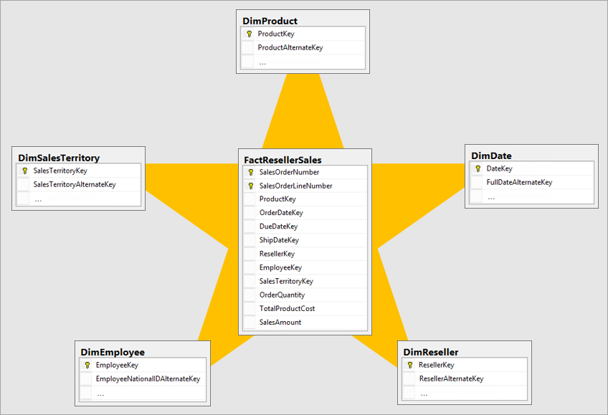
Star Schema
The star schema is a simple and commonly used. It consists of a central fact table surrounded by dimension tables, forming a star-like pattern.
Star schemas are ideal for straightforward reporting and querying. They are efficient for read-heavy operations, making them suitable for dashboards and summary reports.

Slide 4
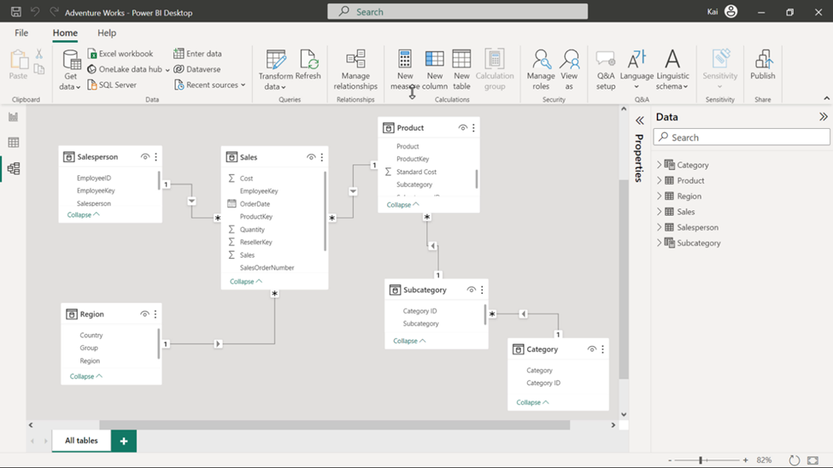
Snowflake Schema
A normalized version of the star schema. In this design, dimension tables are further divided into related tables, resulting in a more complex structure.
Eliminates redundancy by splitting dimension tables into multiple related tables. This results in a web-like structure, resembling a snowflake.
Used in scenarios requiring detailed data models and efficient storage. They are beneficial when dealing with large datasets where data redundancy needs to be minimized.

Slide 5
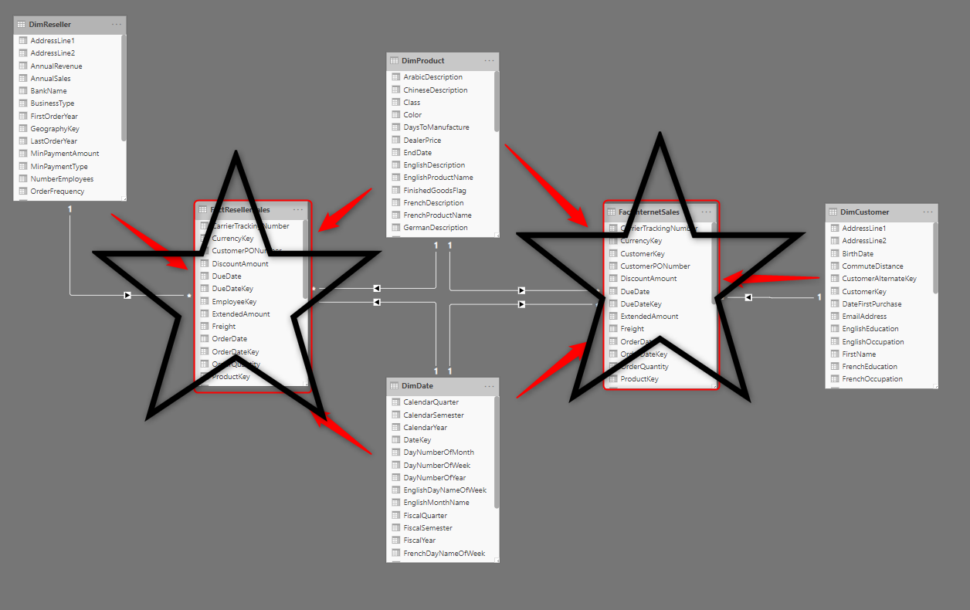
Galaxy Schema
Involves multiple fact tables that share dimension tables, creating a complex, interconnected data model.
This schema consists of multiple fact tables linked to shared dimension tables, enabling the analysis of different business processes within a single model.
Suitable for large-scale enterprise environments where multiple related business processes need to be analysed. They support complex queries and detailed reporting across various domains.

Slide 6

Which one to use?
Snowflake schema structure is common in traditional transactional databases as it is the most efficient way to store the data in those systems. However, this is not the best way to structure data in Power BI.
Power BI’s engine performs best with the star schema.
Star schemas are easier to understand as dimensions can be used to slice and dice data and facts.
Star schema has lesser joins and shorter paths, which means a better performance is guaranteed.
Star schema is more scalable. New dimensions can easily be added.
Every relationship comes at a cost. The extra relationships will potentially have negative performance impacts on the performance.

Slide 7

Facts & Dimension Tables

Slide 8
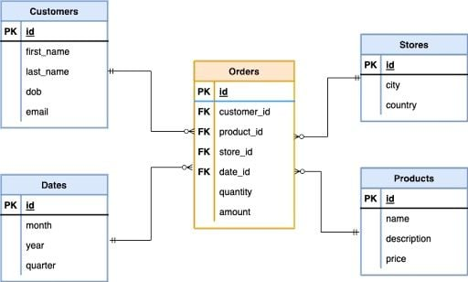
Facts & Dimension Tables
Fact Table
Stores quantitative data or metrics (e.g., sales amount, quantity sold).
Often contains numerical values that business users want to analyse.
Dimension Table
Stores descriptive data or attributes related to facts (e.g., customer name, product category).
Helps provide context for the metrics in fact tables.

Slide 9
Characteristics of Fact Tables
Numeric Data: Contains measurable, numeric data (e.g., revenue, profit).
High Volume of Records: Typically has a large number of rows, capturing events or transactions.
Keys and Foreign Keys: Includes foreign keys that link to dimension tables.
Examples:
Sales Fact Table: Records each transaction with sales amount, units sold, etc.
Order Fact Table: Stores information about each order, including quantity and price.

Slide 10
Characteristics of Dimension Tables
Descriptive Attributes: Contains textual data (e.g., product names, customer demographics).
Primary Keys: Each dimension table has a unique key that links to the fact table.
Smaller in Size: Typically has fewer records than fact tables.
Examples:
Product Dimension Table: Contains product names, categories, and brand information.
Customer Dimension Table: Includes customer names, locations, and demographic data

Slide 11
Cardinality

Slide 12
What is a Cardinality?
In Power BI, cardinality refers to the relationship between two tables in a data model. It describes how many unique values from one table are related to unique values in another table. There are three types of cardinality commonly used in Power BI:

Slide 13
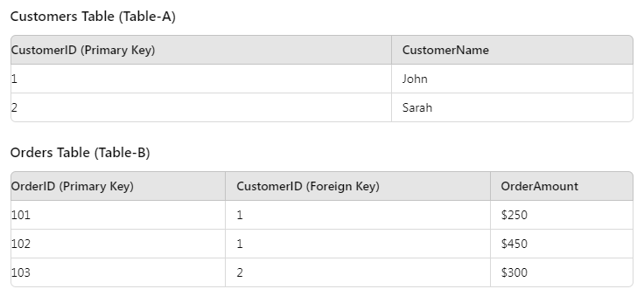
One-to-Many (1:M)
In a one-to-many relationship, each record in one table can be related to multiple records in another table, but each record in the other table is related to only one record in the first table. This is the most common type of relationship in data modelling.

Slide 14
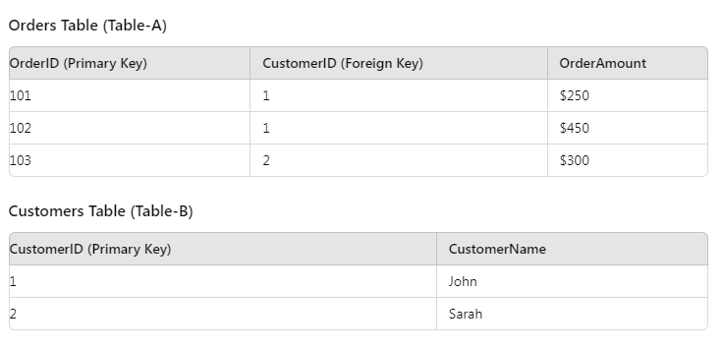
Many-to-One (M:1)
A Many-to-One (M:1) relationship is essentially the reverse of a 1:M relationship. Here, multiple records in one table (Table-A) relate to a single record in another table (Table-B).

Slide 15
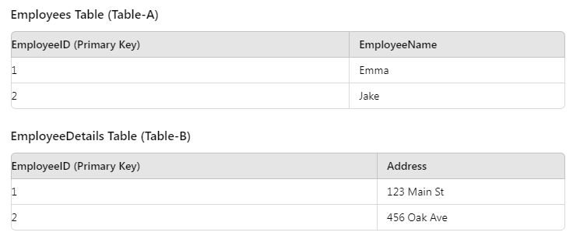
One-to-One (1:1)
In a one-to-one relationship, each record in one table is related to exactly one record in another table, and vice versa. This means that there is a unique match between the two tables based on a common key column.

Slide 16
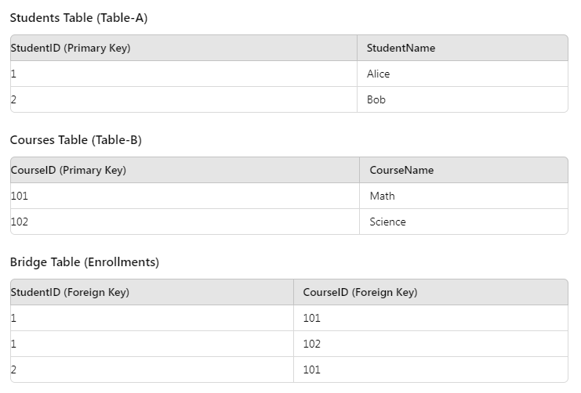
Many-to-Many (M:M)
A Many-to-Many (M:M) relationship occurs when records in one table can relate to multiple records in another table, and vice versa. This type of relationship is more complex and often requires a bridge or intermediary table in Power BI.
𝐄𝐱𝐚𝐦𝐩𝐥𝐞: Consider a "Students" table (Table-A) and a "Courses" table (Table-B). A student can enrol in multiple courses, and each course can have multiple students.

